Slide 1
Trading and Analysis
Project 2 - Group 5
Matt Newman
Samir Sidi
Kevin Lacap
Subash Mishra

Slide 2
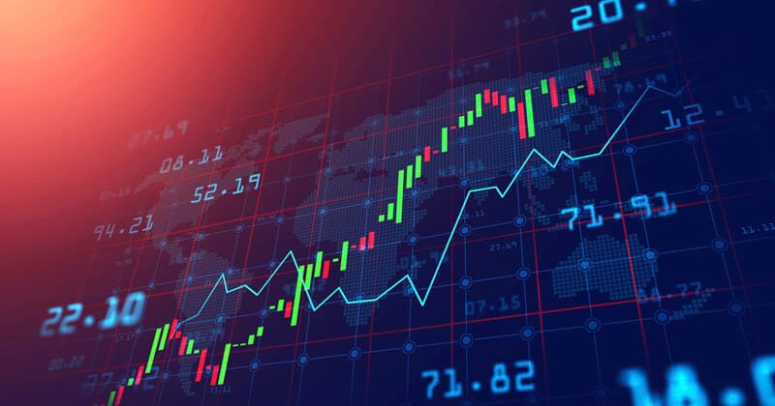
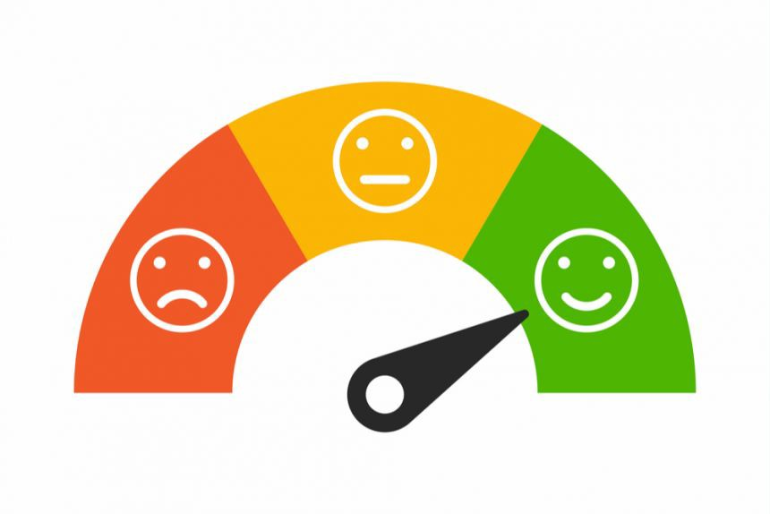
Outline
Introduction and Motivation
Model 1: Technical Analysis
Model 2: Sentiment Analysis
Model 3: Machine Learning
Conclusion and Postmortem

Slide 3
Project Thesis
Conduct technical analysis, sentiment analysis, and machine learning neural network models to generate trade signals and make predictions for various asset classes
Assess which model is most effective for each asset class
Asset Classes: Equities (BA), Cryptocurrency (BTC), Oil (WTI), and FX (USD V. JPY)
Utilize Google Colab to work effectively as a team

Slide 4
Fetching Data and Data Preparation
To ensure reliability and validity of the models, we use the Yahoo API to fetch real-time data
Yahoo API allows us to grab adjusted close making our analysis more accurate and realistic
Boeing(BA) is our default ticker for equities, however our platform allows any tradable ticker(s)

Slide 5
Different Models Used

Slide 6
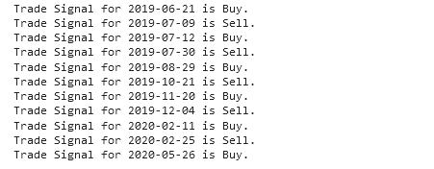
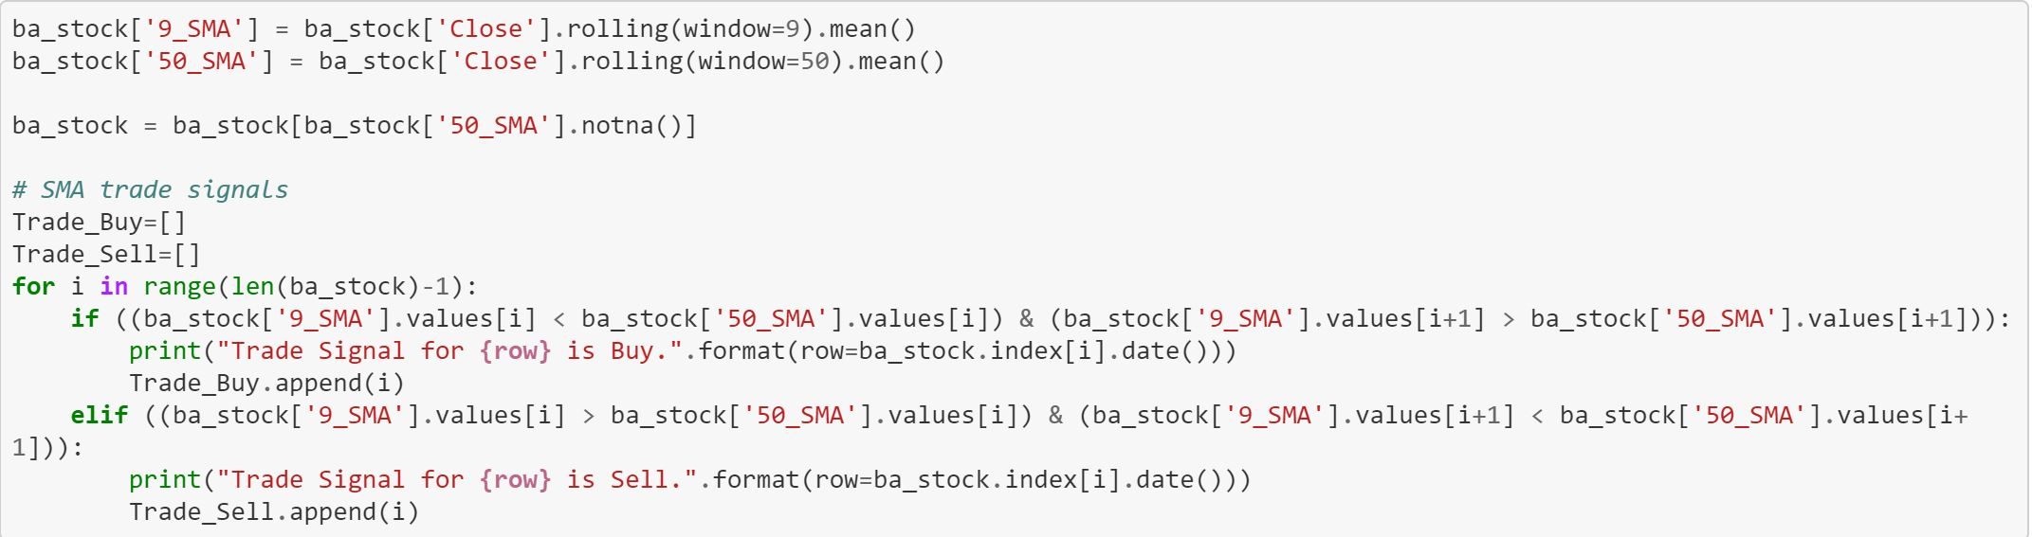
Technical Analysis Model
Moving Average (MA): A calculation to analyze data points by creating a series of averages of different subsets of the full data set
We use 9 days and 50 days MV to generate trading signals. When the ‘9_SMA’ crosses above the ‘50_SMA’ , it’s a buy (Entry) signal. And when the ‘9_SMA’ crosses below the ‘50_SMA’, it’s a sell (Exit) signal.
MA is effective because it illustrates change in sentiment in stocks
Algo’s also pickup on these crossover signals and react
These are the results for BA:

Slide 7
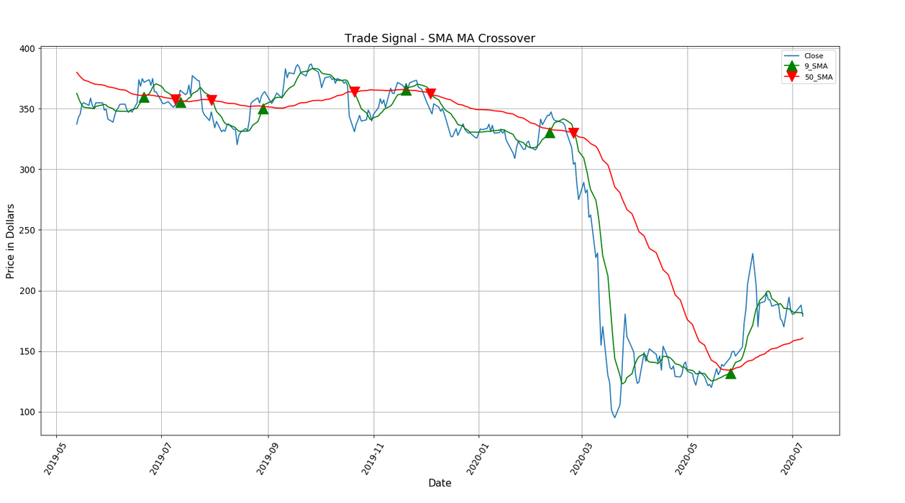
BA SMA Trade Signals

Slide 8
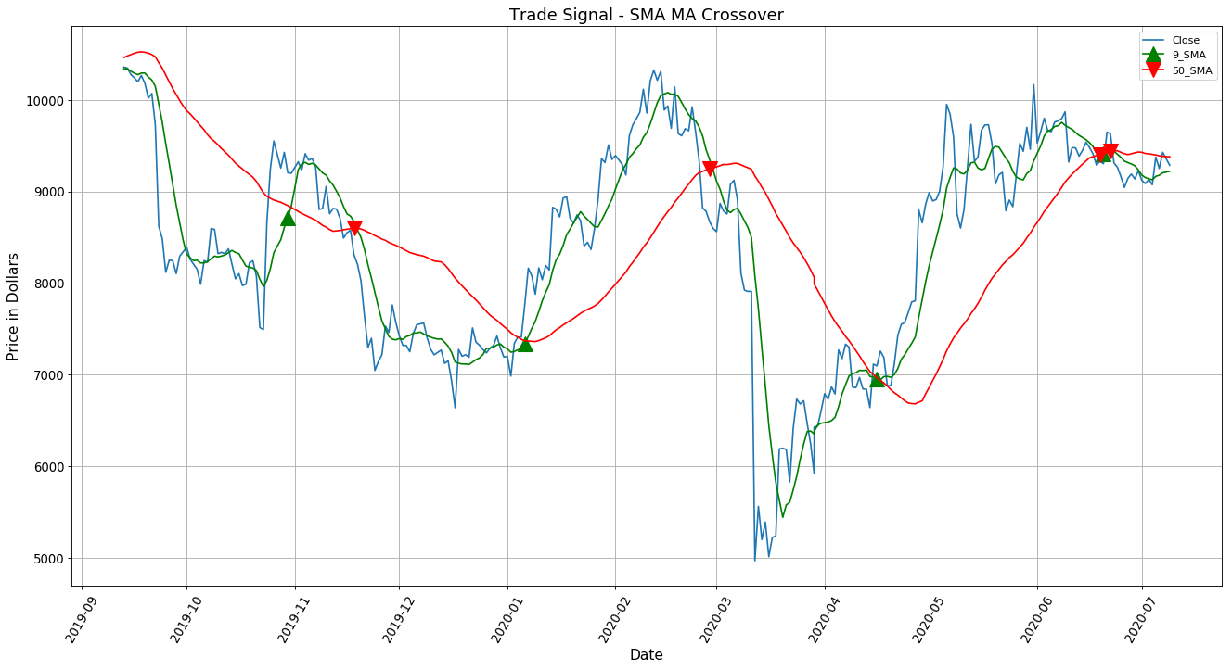
BTC SMA Trade Signals

Slide 9
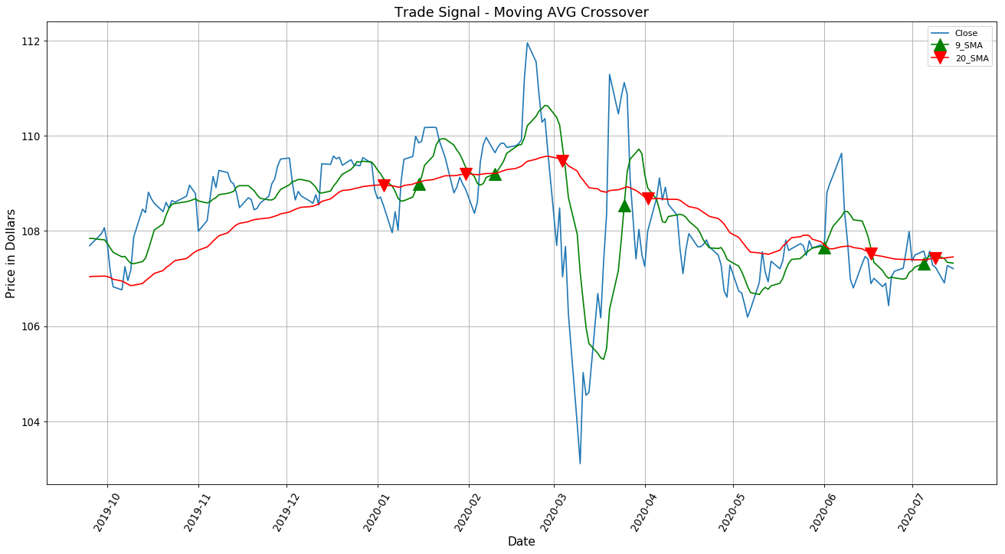
USD V. Yen SMA Trade Signals

Slide 10
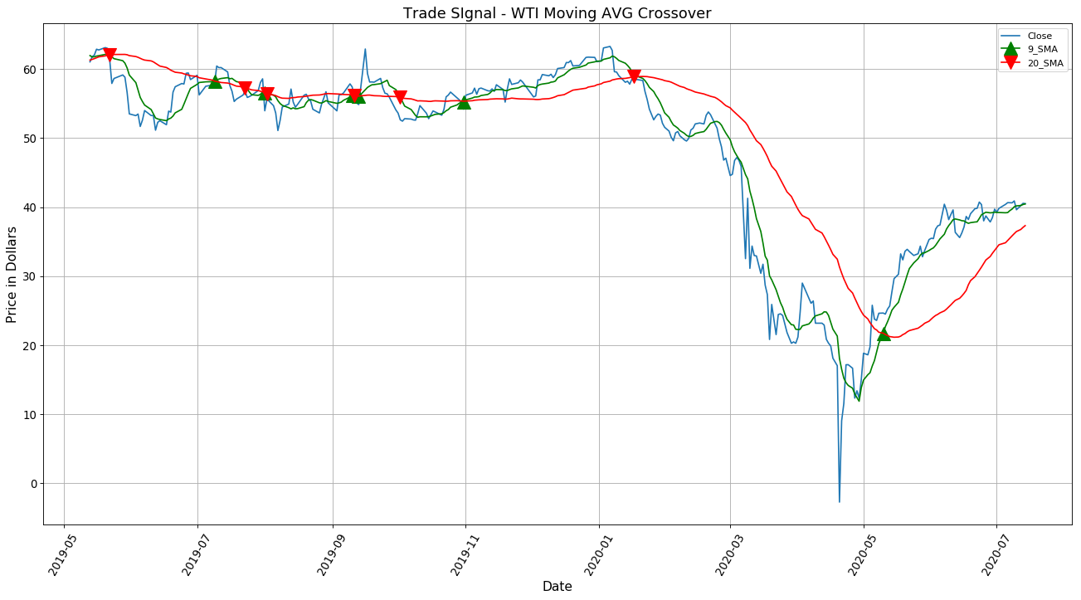
WTI SMA Trade Signals

Slide 11
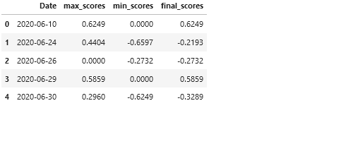
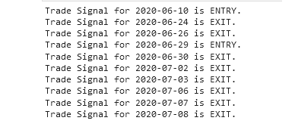
B. Sentiment Analysis Model
VADER measures the sentiment on a scale from -4 to +4, where, -4 stands for the most “negative” and +4 for the most “positive” sentiment
Our model ranks sentiments for each day and takes the average to give a combined uniform score. We deploy our code based on score to segregate buy (score >0.20) and sell (score< 0.2) signals.

Slide 12
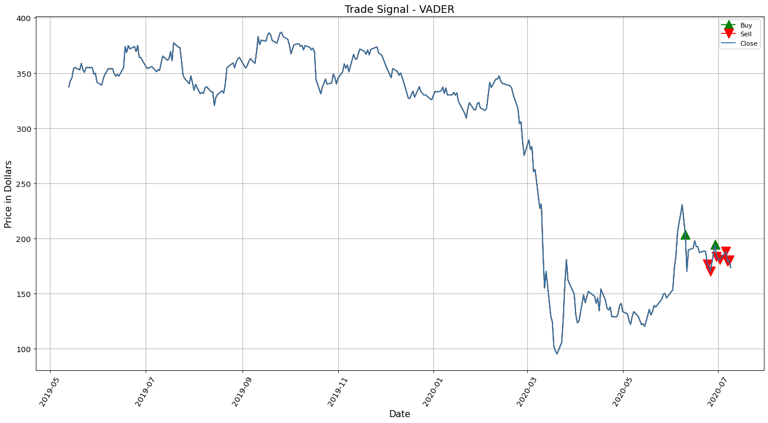
BA VADER Trade Signals

Slide 13
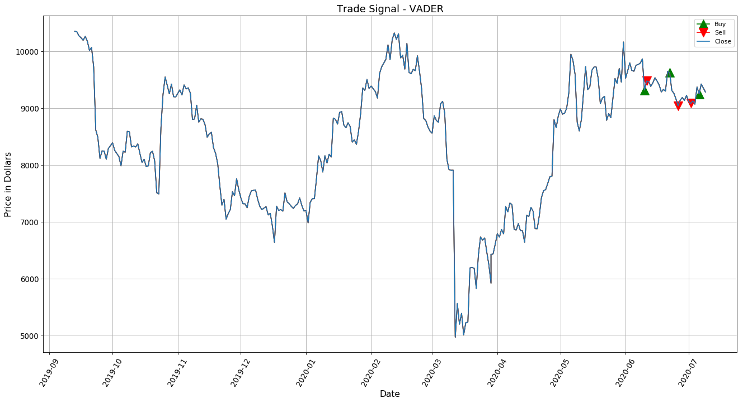
BTC VADER Trade Signals

Slide 14
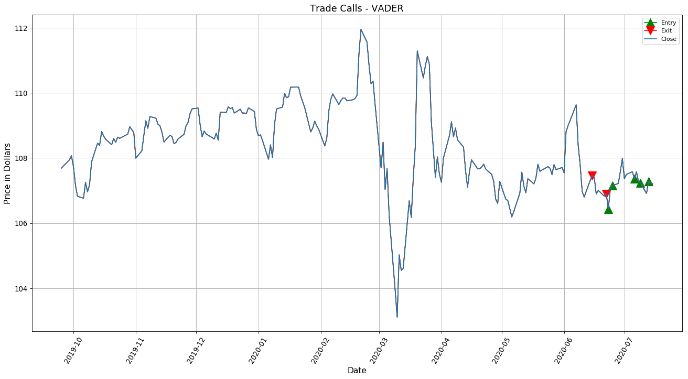
USD V. Yen VADER Trade Signals

Slide 15
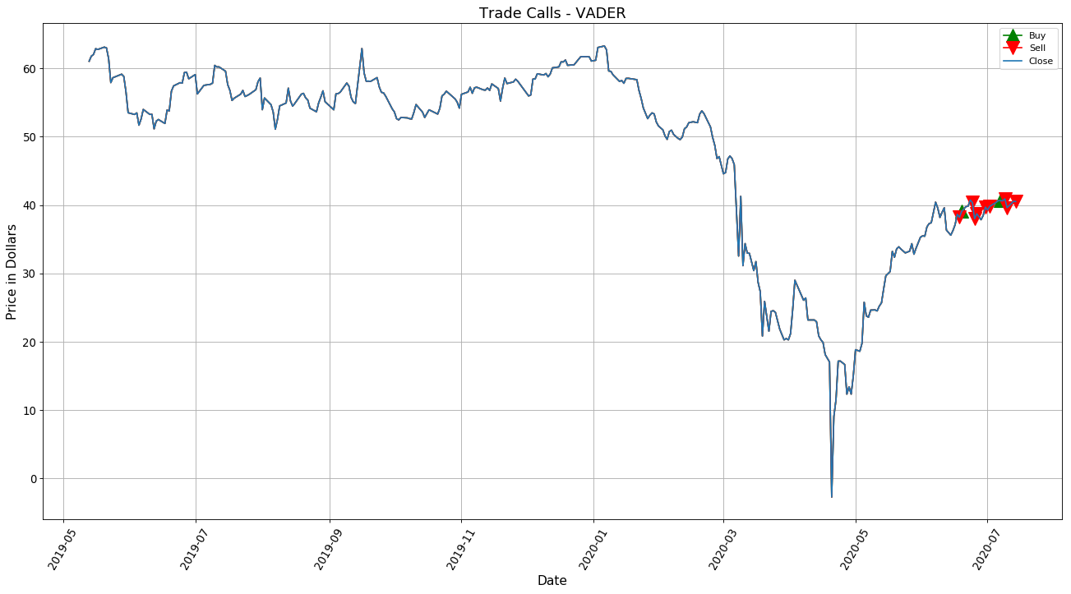
WTI VADER Trade Signals

Slide 16
C. Machine Learning Model
Long Short Term Memory (LSTM): Recurrent neural network uses deep learning to analyze recent iterations and make predictions
Well-suited to classifying, processing and making predictions based on time series data
Increase in epochs included more accurate predictive results

Slide 17
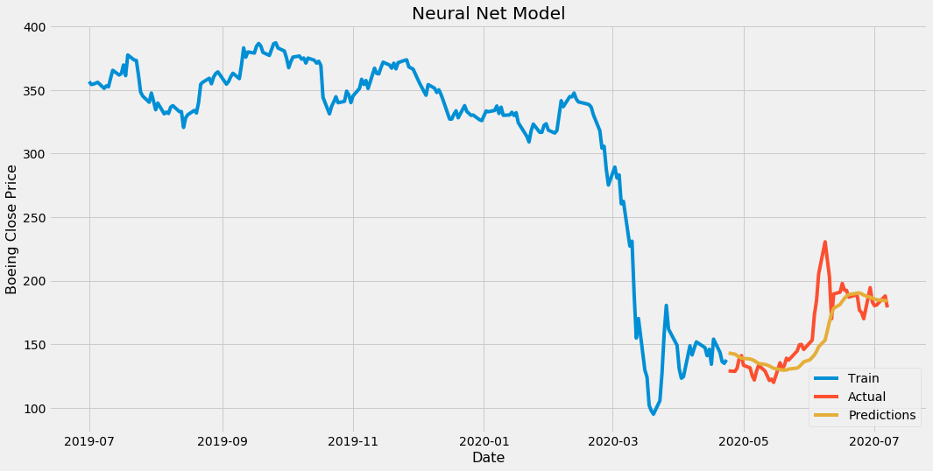
Machine Learning Model (1 Epoch Used)

Slide 18

Machine Learning Model (5 Epoch Used)

Slide 19
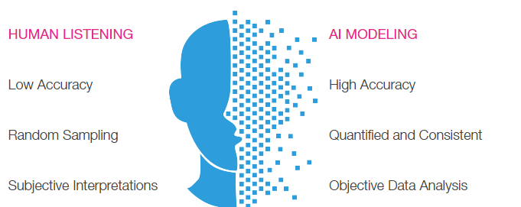
Implications of Findings
We found technical analysis to most consistently deliver accurate predictions
VADER sentiment analysis is more susceptible to misinformation (Opinion pieces, unreliable sources)
Modeling is an effective tool to remove human emotion from trading

Slide 20
Postmortem:
If we had two more weeks:
Create a user interface to allow users to parse in individual ticker(s) for technical, sentiment, and machine learning analysis
Include other technical indicators in code (Fibonacci Retracement, MACD, etc..)
Include social media platforms in sentiment analysis
Back test for longer periods
Overlay plotly graphs
Difficulties:
Creating user interface (Django and Flask)
Accuracy of VADER with NEWS API (Fake News, lack of news sources...)
Learning new optimizers for ML (“Adam”)

Slide 21
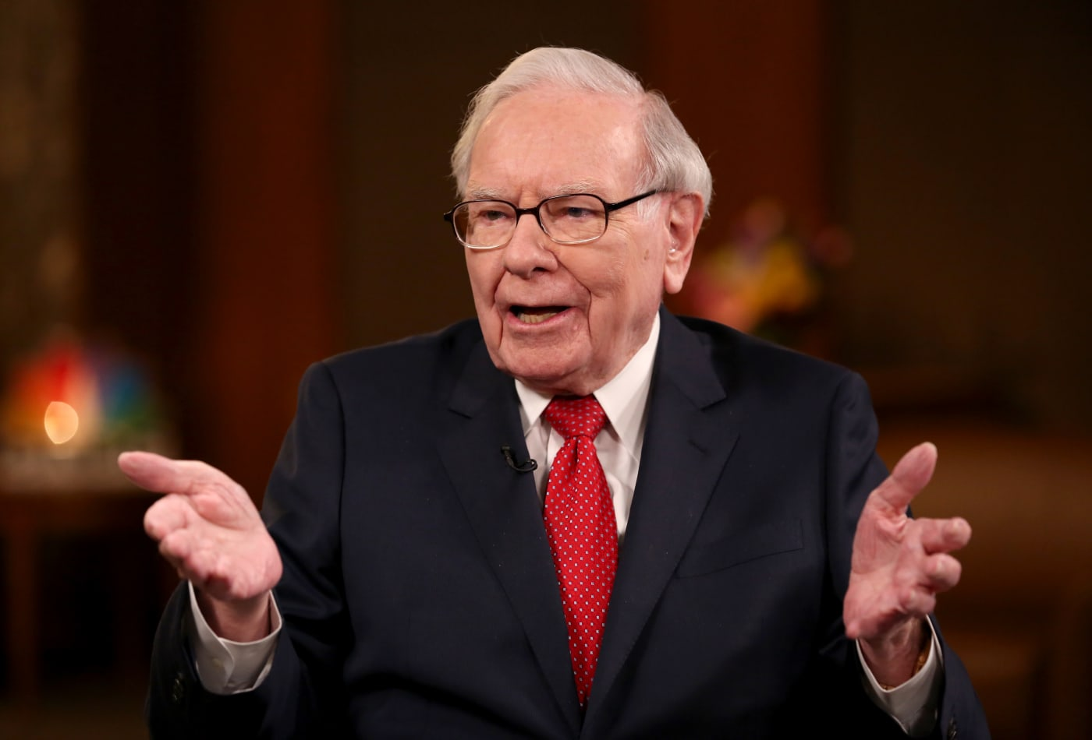
Warren Buffett: “The reason a lot of studies are made of these price and volume variables is that now, in the age of computers, there are almost endless data available about them. It isn’t necessarily because such studies have any utility; it’s simply that the data are there and academicians have worked hard to learn the mathematical skills needed to manipulate them. Once these skills are acquired, it seems sinful not to use them, even if the usage has no utility or negative utility. As a friend said, to a man with a hammer, everything looks like a nail.”

Slide 22
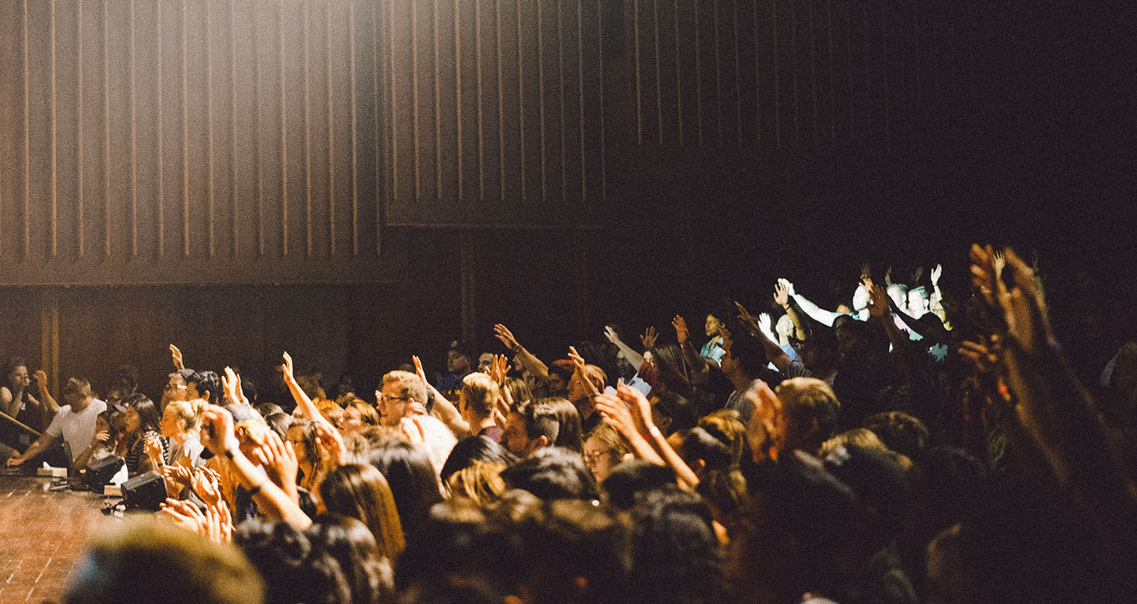
Q & A
Any Questions?

